Slide 1
Analytics 2021 Face Comparison Hackathon
Aayush Shah - 190100003
Ashutosh Sharma - 190100027
Satdhruti Paul - 190100105

Slide 2
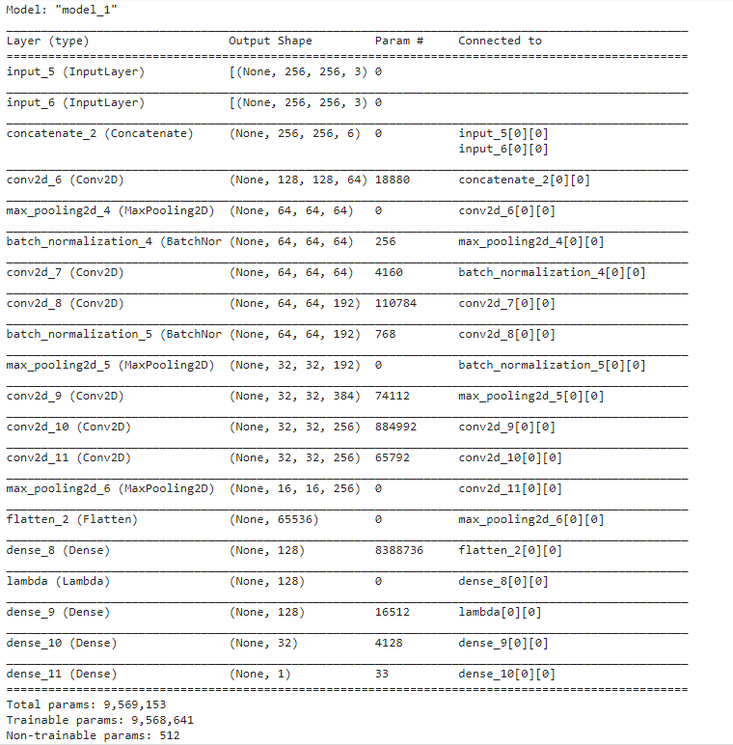
Our Model And Understanding
The problem statement requires us to compare two faces and output if they contain the same person or not.
We ideated a model which takes in two inputs, passes them through some convolution and max pooling layers and at the end after some dense layers there was a sigmoid layer whose output will be 0 or 1. This will be the final output according to the data given
The model was similar to Google’s FaceNet Model but with some modifications.

Slide 3
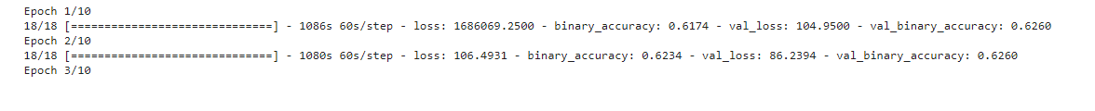
Results
We achieved 87% accuracy on training data and 60% accuracy on validation split with 2 out of 10 epochs run.
The high accuracy of the training set and lower on the validation set suggests that overfitting is taking place.
The training took a long time, around 20 mins per epoch probably due to the higher depth involved. We planned to optimise it by tweaking the model as shown in the next slide

Slide 4
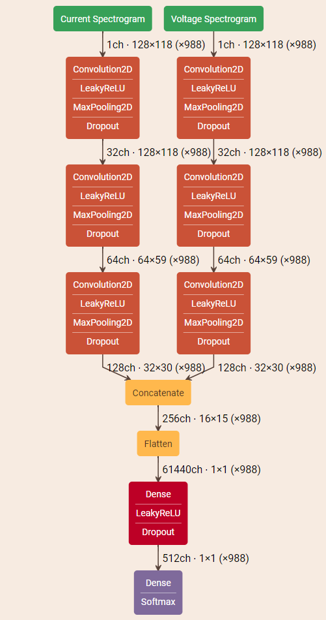
Further Improvements
We have made excess convolution 2d layers which can be reduced and instead we had planned to adopt an approach similar to this (image on right).
Concatenation of similar convolution pathways and then a final conv, relu and softmax layer to get 0/1 output.
More Epochs could’ve been run but we were short on time so we ran 1-2 epochs out of 10 and got 60% accuracy on the validation data split.

